Slide 1




Slide 2

DIRECTIONS

Slide 3

TEST TIME ON CALENDARS
URL: https://forms.gle/CjrdddBi8D3GBYJCA
QR CODE:

Slide 4
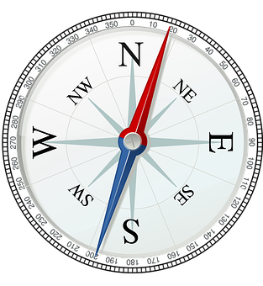
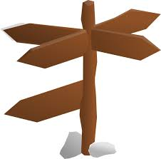
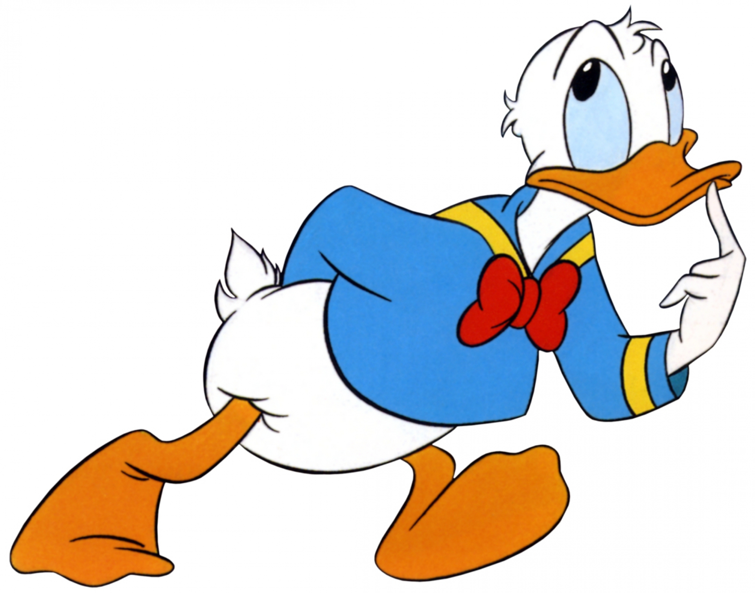

Slide 5
Question: 01
A man goes 50 Km north , then turned left walked 40 Km, then turned right ? In which direction he is?
North
South
East
West
Answer : A

Slide 6
Explanation: 01
5okm-north-->north left-west--->west turned right-north--->north

Slide 7
Question: 02
One afternoon, Manisha and Madhuri were talking to each other face to face in Bhopal on M.G. Road. If Manisha's shadow was exactly to the left of Madhuri, which direction was Manisha facing?
North
South
East
Data inadequate
Answer : A

Slide 8
Explanation: 02
In the afternoon the sun is in the west. Hence, the shadow is in the East. Now, East is to the left of Madhuri. So, Madhuri is facing South. Therefore, Manisha, who is face to face with Madhuri, is facing North.

Slide 9
Question: 03
I am facing West. I turn 45° in the clockwise direction and then 180° in the same direction and then 270° anti-clockwise. which direction am facing now?
South-west
South
West
North-west
Answer : A

Slide 10
Explanation: 03
North
West ___ | ___East
|
South
According to given Question,
I am facing West.
45° + 180° - 270° = -45°
Anticlockwise from initial position. Hence, the required direction is south - west.

Slide 11
Question: 04
Of the 5 towns A,B,C,D and E situated close to each other. A is to the west of B, C is to the south of A,E is to the north of B and D is to the east of E. Then C is in which direction with respect to D?
North-East
North-West
South-West
South-East
Answer : C

Slide 12
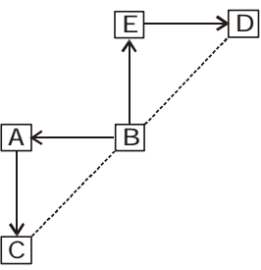
Explanation: 04
Draw a figure as per given instruction in the question. We can see that according to graph Town C is to the south-west of Town D.

Slide 13
Question: 05
Radhika went 50 metres south from her house then turned left and went 20 metres then turning, to north she went 30 metres. In which direction is her home from this point?
North
South-West
East
North-West
Answer : D

Slide 14
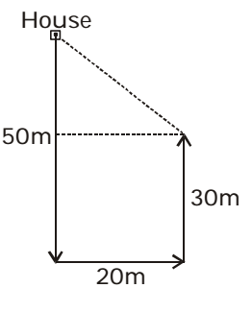
Explanation: 05
Draw a figure as per given instruction in the question. We can see that according to graph

Slide 15
Question: 06
A direction pole was situated on the Road Crossing. Due to an accident, the pole turned in such a manner that the pointer which was showing East, started showing South. Sita, a traveller went to the wrong direction thinking it to be West. In what direction actually she was travelling?
East
South
North
West
Answer : C

Slide 16
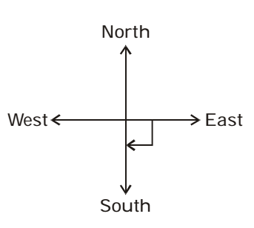
Explanation: 06
Draw a figure as per given instruction in the question. We can see that according to graph Due to an accident, the pointer showing East, started showing South. It means, the pole has been rotated through 90° clockwise. So, when she was travelling towards West, actually it was North.

Slide 17
Question: 07
A man drives his car 6 km towards West, then turns left and drives 3 km and again turns left and drives 3 km. Find out the final direction of the man from his original position.
South-West
North-West
North-East
South-East
Answer : A

Slide 18
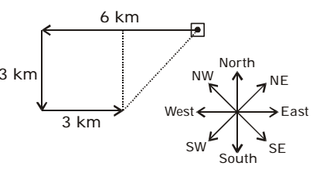
Explanation: 07
Draw a figure as per given instruction in the question. We can see that according to graph the man is to the South West from his original position.

Slide 19
Question: 08
Mr. A travelled from a point ‘X’ straight towards east at a distance of 80 m. He turned to his right and walked 40 m. He again turned to his right and walked 80 m. He then turned his left and walked 20 m and took left and again walked 80m. Now he turned towards his left and walked 60 m and stopped. How far and in which direction is he from the starting point ‘X’?
80 m towards North
60 m towards East
80 m towards West
80 m towards East
Answer : D

Slide 20
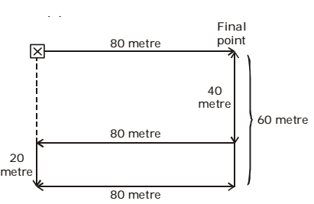
Explanation: 08
Draw a figure as per given instruction in the question. We can see that according to graph It is clear from the above diagram that he is 80 meter towards East from the point X.

Slide 21
Question: 09
A car travelling from south covers a distance of 8 kms, then turns right and runs another 9 kms and again turns to the right and was stopped. Which direction does it face now?
South
North
West
East
Answer : A

Slide 22
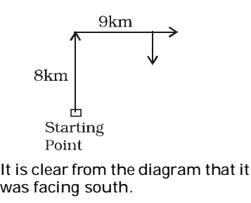
Explanation: 09
Draw a figure as per given instruction in the question. We can see that according to graph travelling from south means movement from south to north.

Slide 23
Question: 10
A tourist drives 10 km towards West and turns to left and takes a drive of another 4 km. He then drives towards East another 4 km and then turns to his right and drives 5 km. Afterwards he turns to his left and travels 6 km. In which direction is he from the starting point?
North
East
West
South
Answer : D

Slide 24
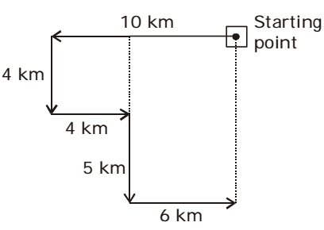
Explanation: 10
Draw a figure as per given instruction in the question. We can see that according to graph he is in south direction from the starting point.

Slide 25
Question: 11
Raghu starts from his house in his car and travels 8 km towards the North, then 6 km towards East then 10 km towards his right, 4 km towards his left, 10 km towards North and finally 4 km towards his right. In which direction is he now with reference to the starting point?
South
North East
South East
North
Answer : B

Slide 26
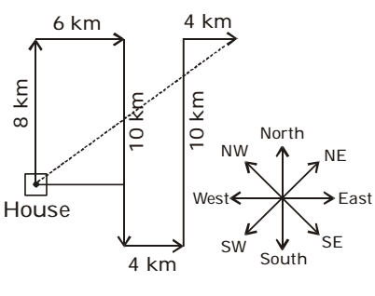
Explanation: 11
Draw a figure as per given instruction in the question. We can see that according to graph

Slide 27
Question: 12
Raju is standing facing north. He goes 30 metres ahead and turns left and goes for 15 metres. Now he turns right and goes for 50 metres and finally turns to his right and walks. In which direction is he heading?
North
East
South
West
Answer : B

Slide 28
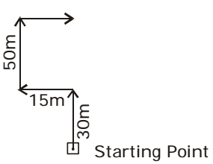
Explanation: 12
Draw a figure as per given instruction in the question. We can see that according to graph he is heading towards east.

Slide 29
Question: 13
Alok walked 30 metres east and took a right turn and walked 40 metres. He again took a right turn and walked 50 metres. Towards which direction is he from his starting point?
South
West
South-West
South-East
Answer : C

Slide 30
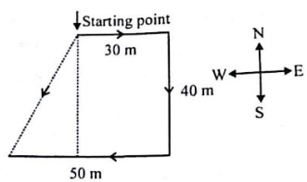
Explanation: 13

Slide 31
Question: 14
M is to the East of D, F is to the South of D and K is to the East of F. M is in which direction with respect to K?
South-West
North-West
North-East
South-East
Answer : C

Slide 32
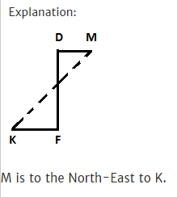
Explanation: 14

Slide 33
Question: 15
A man walks 1 km towards East and then he turns to South and walks 5 km. Again he turns to East and walks 2 km, after this he turns to North and walks 9 km. Now, how far is he from his starting point?
3 km
4 km
5 km
7 km
Answer : C

Slide 34
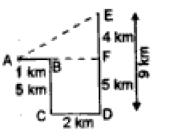
Explanation: 15

Slide 35
Question: 16
Laxman travels 7 km towards south and then 5 km towards his left. He further travels 5 km towards south. How far is he from the starting point?
13 km
9 km
√149 km
√119 km
Answer : A

Slide 36
Explanation: 16
A person box 4 km towards weds then turns to his right to travel 9 km he turns towards east and travels 12 km finally Travels 2 km to a South how far is he from the initial position in kilometre

Slide 37
Question: 17
Rahul put his timepiece on the table in such a way that at 6 P.M. hour hand points to North. In which direction the minute hand will point at 9.15 P.M. ?
9.15 PM
9 Am
9 Pm
2.15Pm
Answer : A

Slide 38
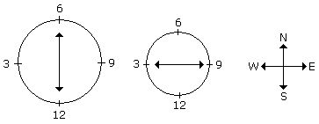
Explanation: 17
At 9.15 P.M., the minute hand will point towards west.

Slide 39

https://learn.codemithra.com

Slide 40




THANK YOU
+91 78150 95095
codemithra@ethnus.com
www.codemithra.com

